Slide 1

IPL Data
EDA

Slide 2
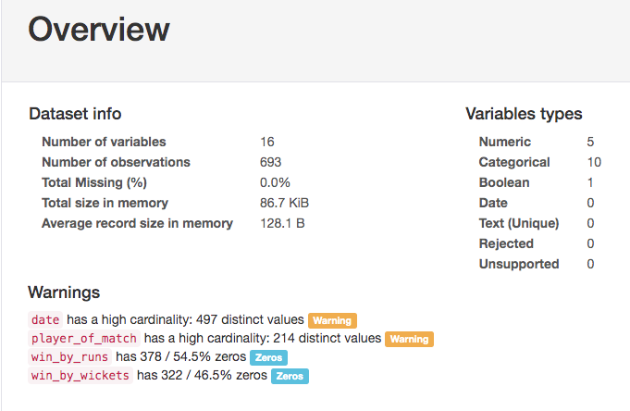
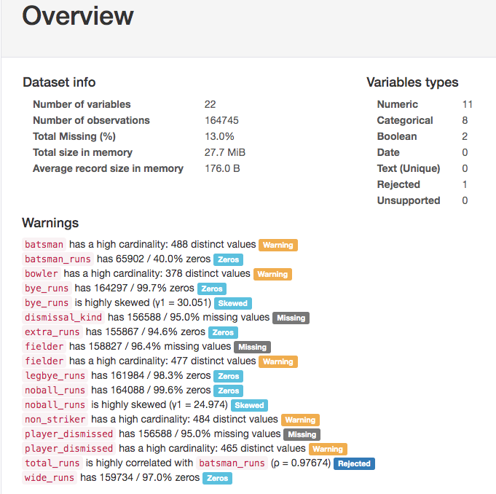
OVERVIEW OF DATASETS

Slide 3
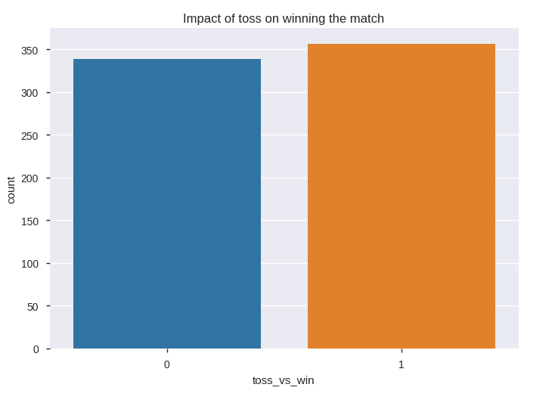
Empact of toss on winning the match
We don’t see much impact of toss on winning the match in IPL.

Slide 4
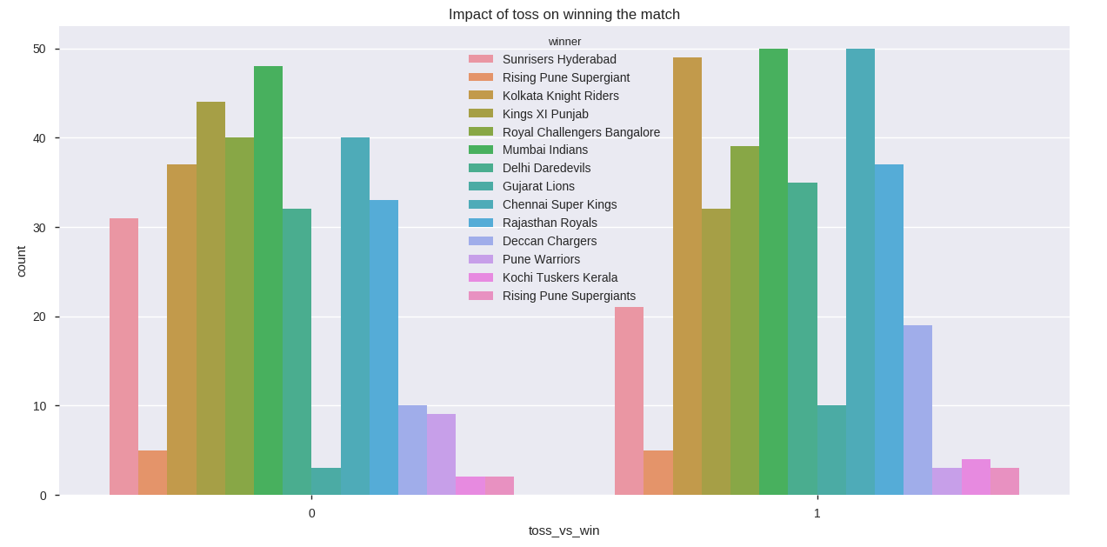
Empact of toss on winning the match

Slide 5
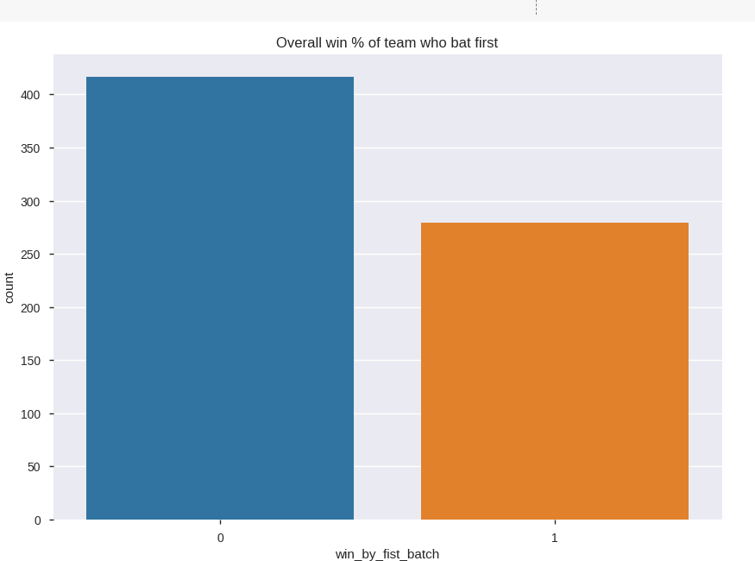
Win % of team who bat first
Only 40% of time the team who bat first won the match and 60% the caching team has a chance to win.

Slide 6
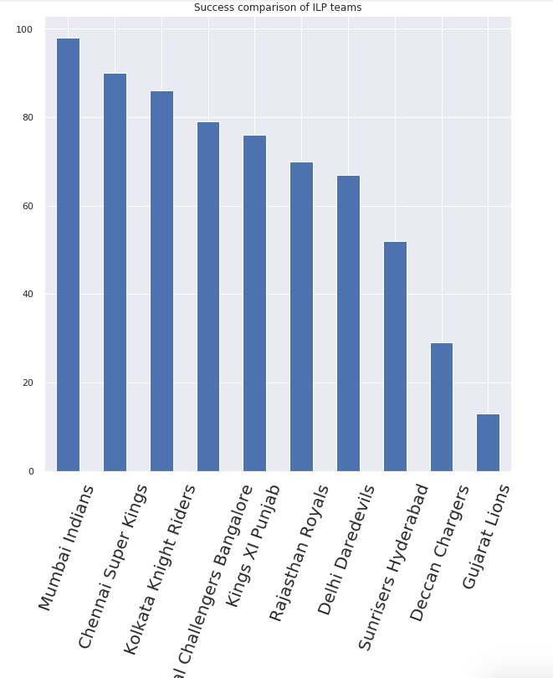
Success comparison of IPL team
Mumbai Indians have won highest numbers of matches

Slide 7
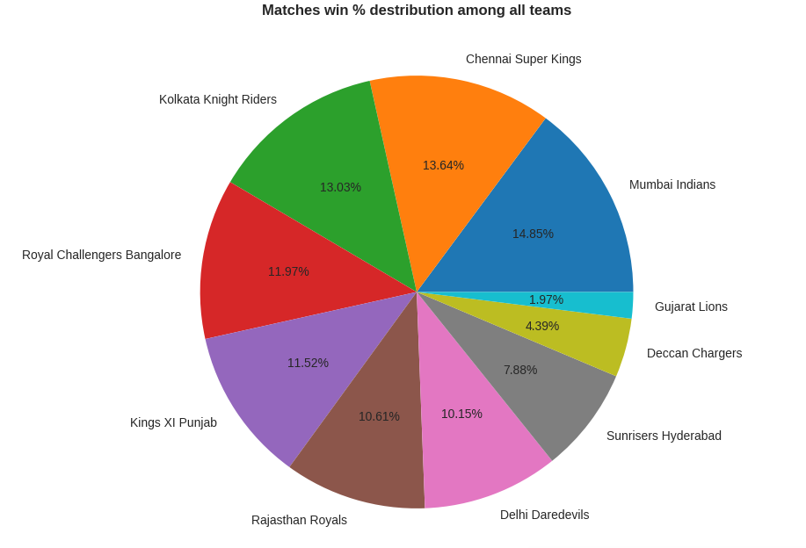
Matches win % distribution between all teams

Slide 8
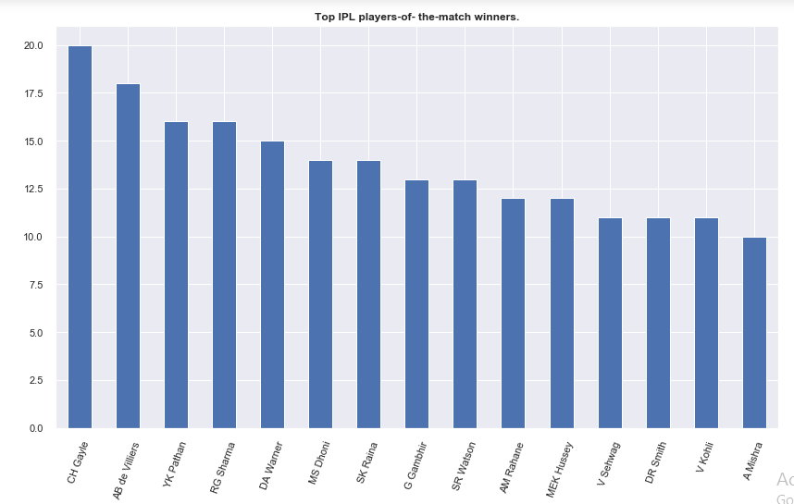
Player-of-the-match winners
CH Gayle has won highest number of time player-of-the-match in ILP

Slide 9
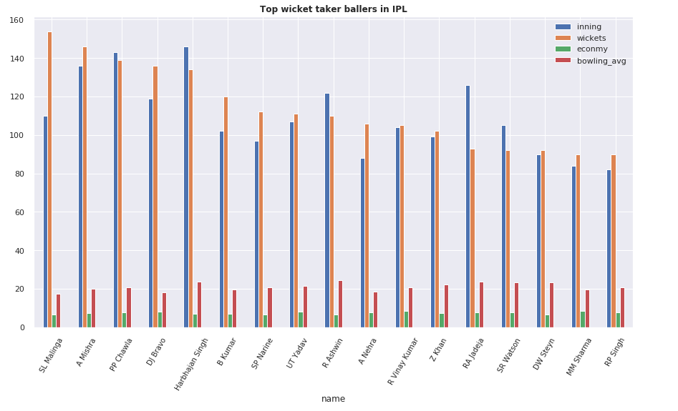
Top wicket taker bowlers in IPL

Slide 10
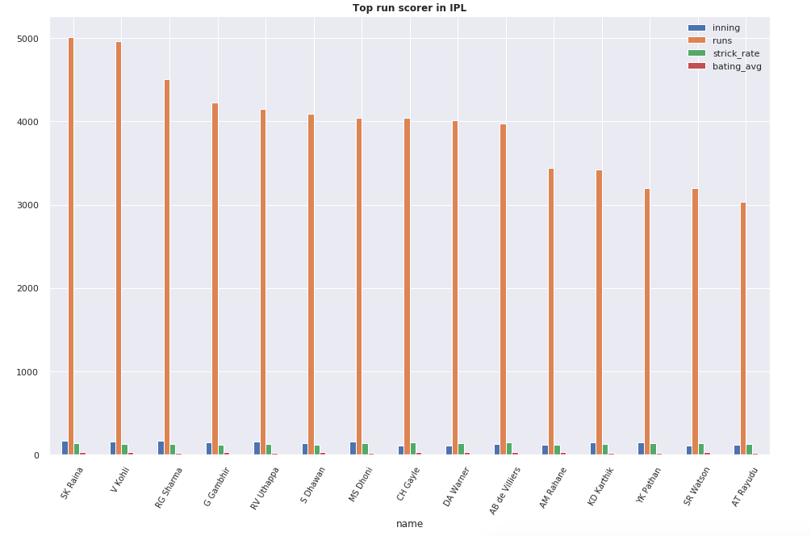
Top run scorer batsman’s in IPL

Slide 11
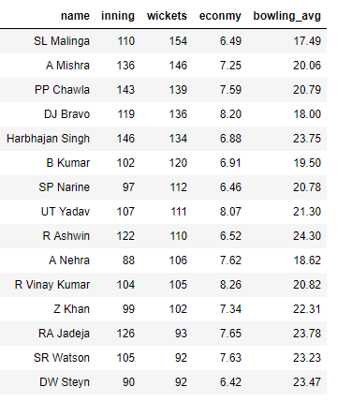
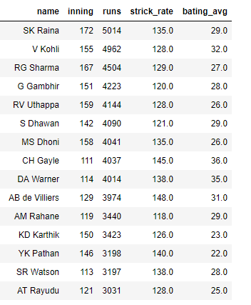
Top wicket taker bowler
Top run scorer batsman's

Slide 12
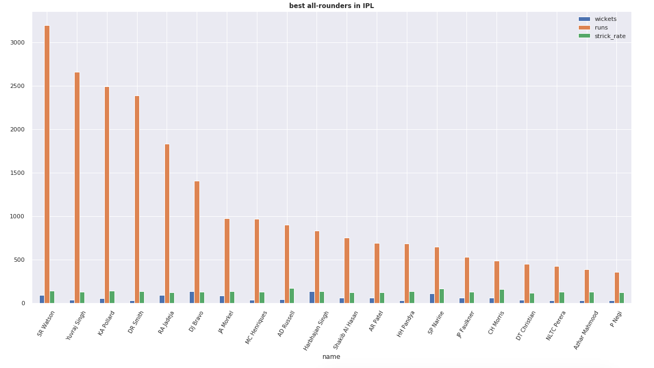
Best all-rounder player

Slide 13
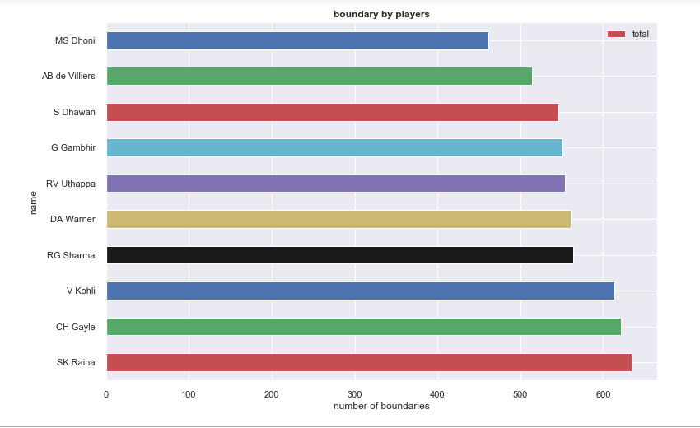
Players who had hit highest number of boundaries

Slide 14
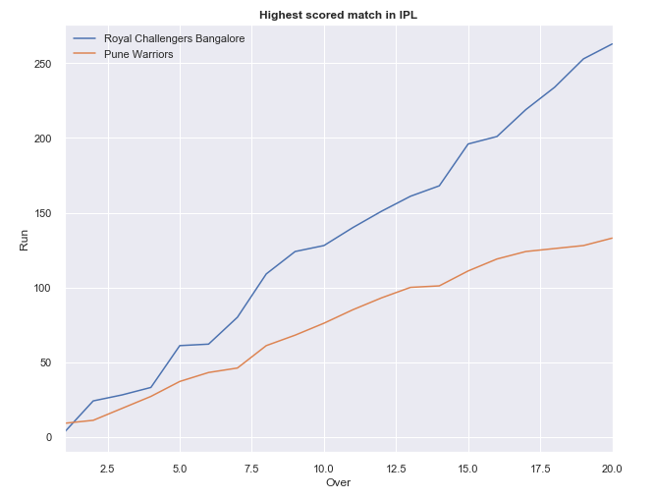
Highest scored match in IPL
Highest scored match in IPL was between RCB and Pune Warriors.
RCB scored 263 and chasing to that Pune Warriors scored 133

Slide 15
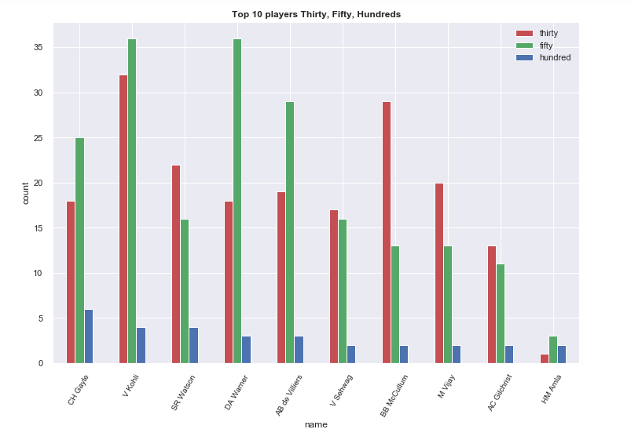
Top 10 thirties, fifties, and hundreds of players

Slide 16
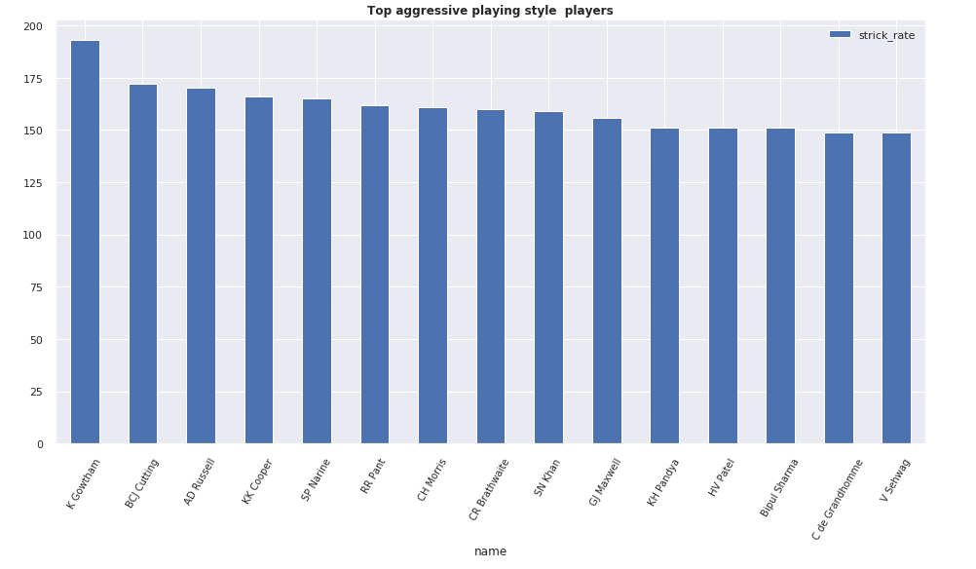
Aggressive playing style players

Slide 17
Conclusion
The team who bat second 60% of the time they have chance win the match.
Mumbai Indian has won more matches then other teams.
CH Gayle has won highest number of time Player of the match.
SL Malinga is highest wicket taker in IPL with 154 wickets in 110 innings
39.2 % matches has been high scoring(more then 180) in IPL
Top score made their 55% to 70% runs by boundaries.
Around 526 player have been played IPL league.

